Slide 1
OBJECTIVE
Using superstore sales data to contribute to the success of business by utilizing data analysis techniques focusing on time series analysis to provide valuable insights and accurate sales forecasting.
To analyze sales profit and customer behavior across regions, categories and time periods in order to
Identify Top performing areas
To track YoY and MoM trends
To optimize product and regional strategy.
Improve profitability

Slide 2
DATASET SUMMARY
File includes fields such as Category,City,Country, Customer ID, Customer name,
OrderID, Payment Mode, ProductID, Product Name, Profit, Quantity, Region,Returns, RowID, Sales, Segment, Ship Mode, State, Ship-mode, Sub-Category.

Slide 3
Dashboard structure
Superstore sales performance overview
KPIs: Total Sales, Total Profit, Total Orders, Profit Margin, AOV
Charts:
Sales and profit trend per category(line + bar chart).Line is profit and column.
Sales by Shipmode(Bar chart)
Monthly Sales by YoY(Line Chart).
Monthly Sales by MoM(Line Chart)
Sales & Profit by State(Filled Chart)
Sales by Payment Mode(Donut Chart)
Sales by Segment(Donut Chart)

Slide 4
DAX Measures and Columns used
AOV = SUM(SuperStore_Sales_Dataset[Sales])/ [Total Orders]
Filtered Sales(Furniture Only) = CALCULATE(SUM(SuperStore_Sales_Dataset[Sales]), SuperStore_Sales_Dataset[Category] = "Furniture")
Last Year Sales = CALCULATE('SuperStore_Sales_Dataset'[Total Sales],SAMEPERIODLASTYEAR('SuperStore_Sales_Dataset'[Order Date]))
** Calculate the sales from the same period in the previous year(Requires a proper date column)
Profit Margin = DIVIDE(SUM('SuperStore_Sales_Dataset'[Profit]), SUM('SuperStore_Sales_Dataset'[Sales])
** Percentage of Profit
Profitability Efficiency = [Total Profit]/[Total Sales]
Total No of Orders = DISTINCTCOUNT(SuperStore_Sales_Dataset[Order ID])
Total Profit =
SUM('SuperStore_Sales_Dataset'[Profit]) * SUM('SuperStore_Sales_Dataset'[Quantity])
Total Profit = SUM('SuperStore_Sales_Dataset'[Profit]) * SUM('SuperStore_Sales_Dataset'[Quantity])

Slide 5
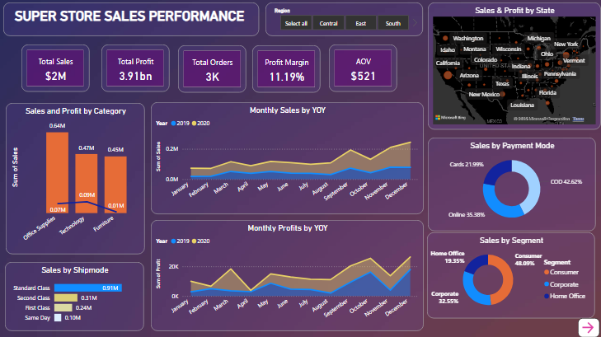

Slide 6
Dashboard structure
Superstore sales performance overview
KPIs: Average Delivery Days, Profitability Efficiency
Charts:
Sales and profit trend per Sub category(stacked bar chart).
Profit by Segment(Bar chart)
Profitability by Sub-Category(Scatter Chart)
Monthly Sales by Category (Line Chart).
Sales Forecast by Order Date (Line Chart)

Slide 7
